Slide 2

0
1
Lesson 01
Counting I-Basic Rule

Slide 3
Lead in
The Sum Rule
If an event E₁ can happen in n₁ ways, event E₂ can happen in n₂ ways, event E_{k} can happen in n_{k} ways, and if any event E₁, E₂, … or E_{k} happens, the job is done, then the total ways to do the job is n₁+n₂+…+n_{k}.

Slide 4
Lead in
The Product Rule ( Fundamental Counting Principle )
When a task consists of k separate parts, if the first part can be done in n₁ ways, the second part can be done in n₂ ways, and so on through the k^{th} part, which can be done in n_{k} ways, then total number of possible results for completing the task is given by the product:
n₁×n₂×n₃×…×n_{k}

Slide 5
Part 1
Basic Counting Rule

Slide 6

Example
Example 1.
How many 4-digit numbers can be formed using the digits of 1,2,3,4 and 5?

Slide 7
Example
Example 2.
How many 4-digit numbers can be formed using the digits of 1,2,3,4 and 5? No digit can be used twice in any such 4-digit number.

Slide 8
Example
Example 3.
How many 4-digit numbers can be formed using the digits of 0,1,2,3 and 4? No digit can be used twice in any such 4-digit number.

Slide 9
Example
Example 4.
How many 4-digit odd numbers can be formed using the digits of 0,1,2,3 and 4? No digit can be used twice in any such 4-digit number.

Slide 10
Example
Example 5.
How many 4-digit even numbers can be formed using the digits of 0,1,2,3 and 4? No digit can be used twice in any such 4-digit number.

Slide 11
Part 2
Extra Example about Basic Counting Rule

Slide 12
Example
Example 6.
How many two-digit positive integers have at least one 5 as a digit?
(A) 12 (B) 18 (C) 21 (D) 25 (E) 35

Slide 13
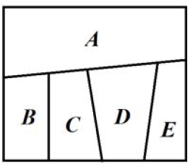
Example
Example 7.
As shown in the figure below, each of five regions ABCDE is to be assigned a color. There are 5 colors to choose from, and no adjacent regions can be the same color. How many different ways are there if each color is allowed to be used more than once?
(A) 360 (B) 540 (C) 720 (D) 1440 (E) 180

Slide 14

Example
Example 8.
Using red, yellow, blue, and black colors to color the figure as shown. Each region is colored with one color and no adjacent region can have the same color. If each color is allowed to use more than once, how many ways are there to color?
(A) 48 (B) 36 (C) 30 (D) 24 (E) 42

Slide 15
Example
Example 9. (Challenge)
As shown in the figure below, each of four regions ABCD is to be assigned a color. There are 4 colors to choose from, and no adjacent regions can be the same color (Two regions are adjacent if they share at least one side). How many different ways are there if each color is allowed to be used more than once?

Slide 16
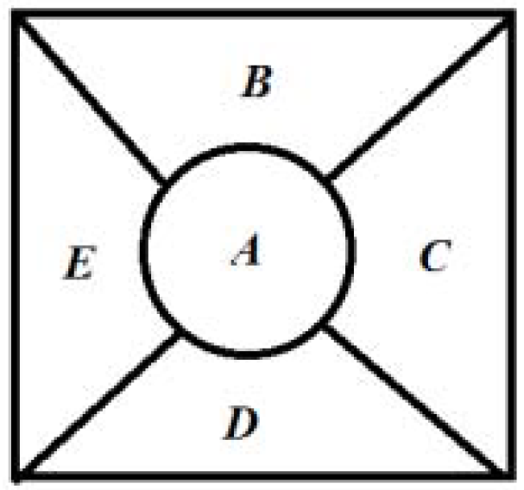
Example
Example 10.
There are five regions that need to be colored by six different colors as shown in the figure. Each region can only be colored with one color and no adjacent regions can be the same color. How many different ways are there to do the coloring?
(A) 1440 (B) 720 (C) 1560 (D) 1024 (E) 2016

Slide 17
Part 3
Past Problem of AMC 10

Slide 18
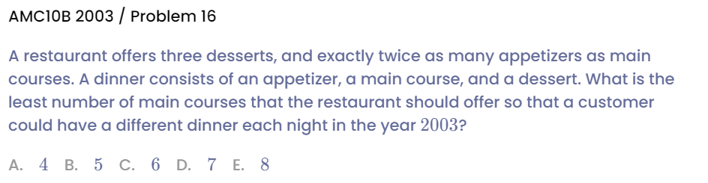
Example

Slide 19
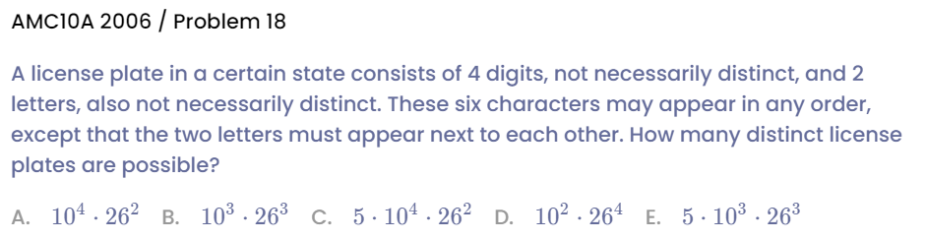
Example

Slide 20
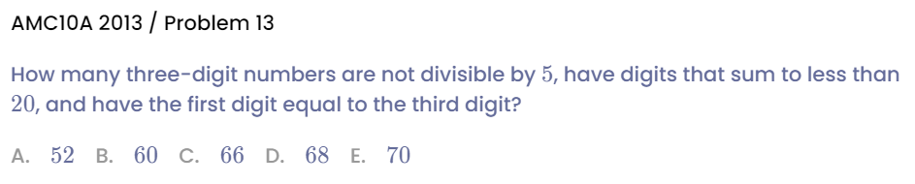
Example

Slide 21
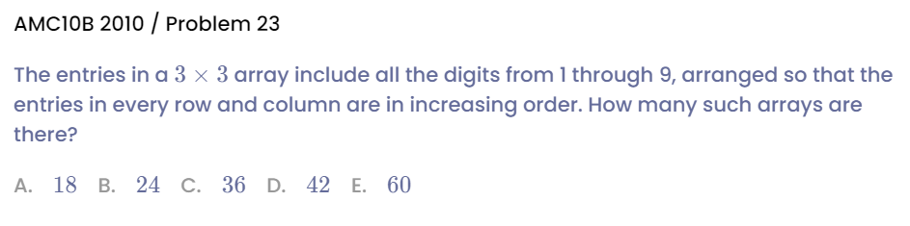
Example

Slide 22
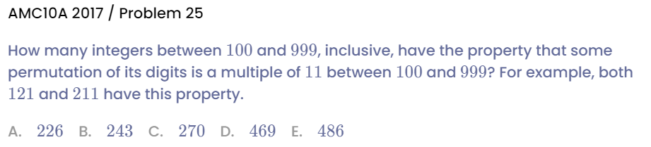
Example

Slide 23
See You Next Time!

